Slide 1


IT Support Performance Analysis
Improving Efficiency, Satisfaction & Decision Making

Slide 2


Why This Analysis Matters ?
Executive Summary
Ticket demand is increasing steadily
Avg resolution time is 4.55 days (optimization opportunity)
Performance varies across agents and categories
System & software issues take longest
Key Solution: Training + Automation (not hiring)
Problem Statement
Increasing IT support demand ⚠️
Delays in ticket resolution (~4.55 days) ⏱️
Need to improve agent efficiency 📊
Maintain high satisfactioN

Slide 3


Project Objective
01
02
Count of Tickets by Request Category
Count of Ticket ID by Time
03
04
Average Resolution Time by Request Category
Satisfaction Rate by Time
05
06
Ticket Distribution by Severity
Age Group by Satisfaction Rate

Slide 4

TOP KPI’S
Total number of IT support tickets raised
Represents overall workload of the IT support team
Helps in resource planning
01
1. Total Ticket Volume = 97498
02
Average time taken to resolve tickets
Measures team efficiency
Lower resolution time indicates better performance
2. Average Resolution Time = 4.53 Days
03
Overall employee satisfaction rating
Measures service quality
Higher score indicates better support experience
3. Satisfaction Rate by Time = 4.101
04
4. Overloaded Tickets = 72382
Number of tickets exceeding normal workload capacity
Indicates pressure on IT support team
Helps identify need for additional resources or process improvements

Slide 5
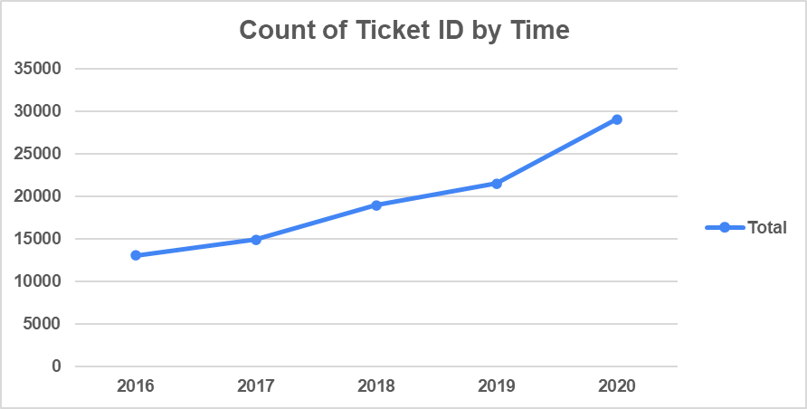
KEY INSIGHTS
Insight 1 – Count of Ticket ID by Time
Shows the number of tickets raised over a period of time
Helps identify peak workload periods
Useful for resource planning and staffing decisions
Highlights trends in IT support demand

Slide 6
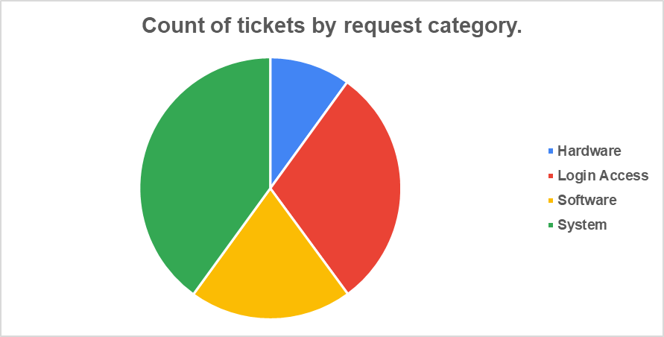

Insight 2 – Count of Tickets by Request Category
Displays ticket distribution across different request categories
Identifies most common IT issues
Helps allocate resources to high-demand categories
Supports process improvement in frequently occurring issues

Slide 7
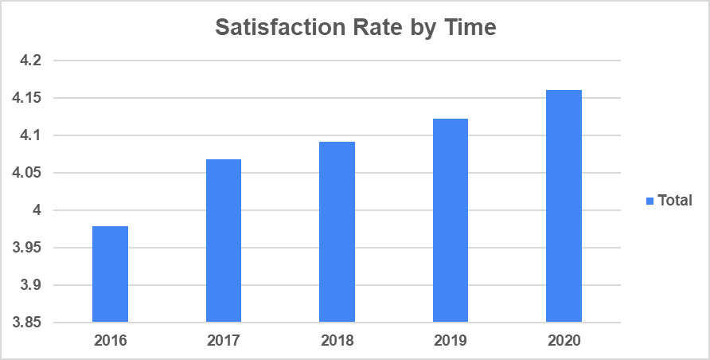
Insight 3 – Satisfaction Rate by Time
Shows employee satisfaction trends over time
Helps measure service quality improvement or decline
Identifies periods with low satisfaction levels
Supports decision-making for service improvements

Slide 8
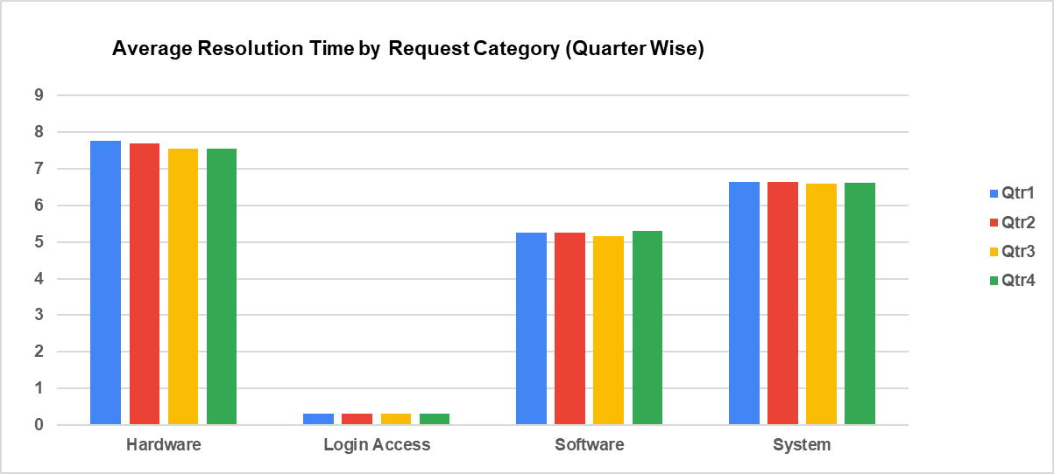
Insight 4 – Average Resolution Time by Request Category (Quarter Wise)
Displays average resolution time across categories quarterly
Identifies slow-performing categories
Helps track performance improvement over time
Supports optimization of ticket resolution process

Slide 9
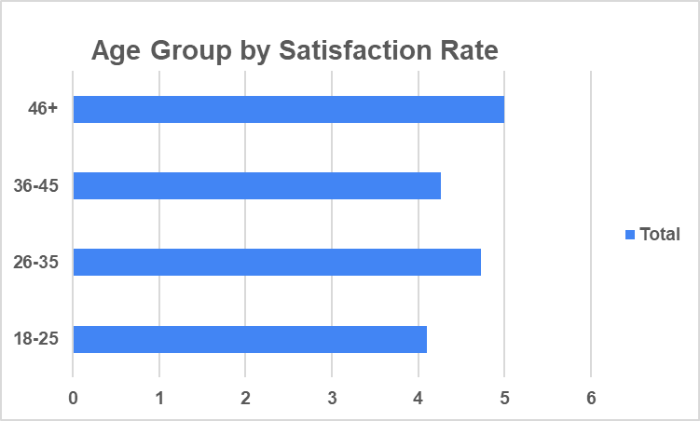
Insight 5 – Age Group by Satisfaction Rate
Shows satisfaction levels across different age groups
Helps understand user experience by demographic group
Identifies groups with lower satisfaction
Supports targeted service improvements

Slide 10
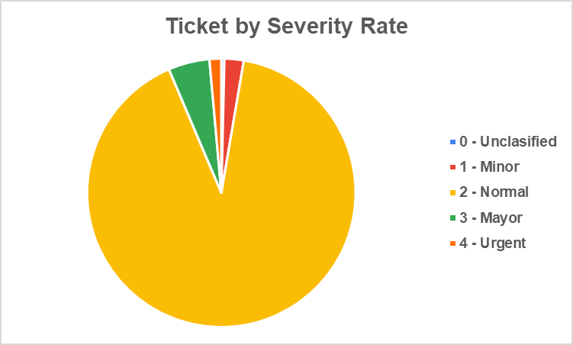
Insight 6 – Ticket by Severity Rate
Displays distribution of tickets based on severity level
Helps identify high-priority ticket volume
Assists in prioritizing urgent issues
Supports workload management

Slide 11
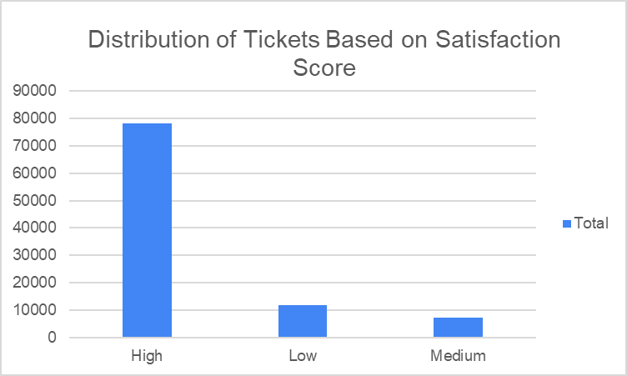
Insight 7 – Distribution of Tickets Based on Satisfaction Score
Shows how satisfaction scores are distributed
Identifies overall service quality trends
Highlights frequency of low satisfaction ratings
Helps improve customer experience

Slide 12
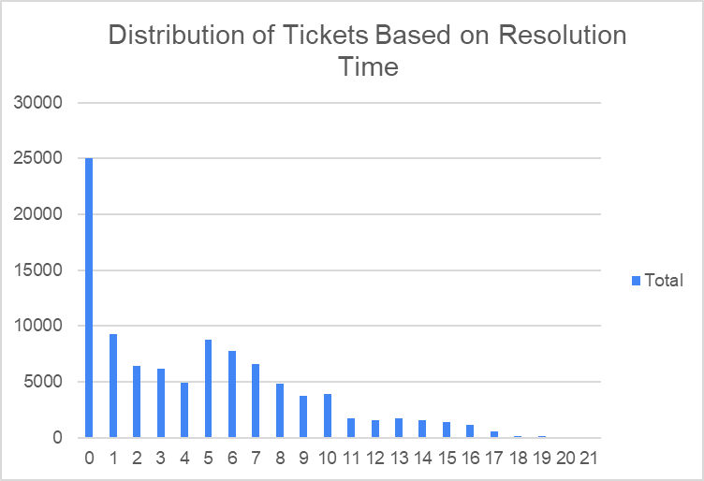
Insight 8 – Distribution of Tickets Based on Satisfaction Score
Shows how satisfaction scores are distributed
Identifies overall service quality trends
Highlights frequency of low satisfaction ratings
Helps improve customer experience

Slide 13

Issue Type
Majority of tickets are requests (not errors)
Fewer critical failures
👉 Problem → Too many repetitive tasks
👉 Insight → Most work is predictable
👉 Opportunity → Can be automated
Most of the tickets are service requests rather than system failures → which means a large portion of work is repetitive → and this creates a strong opportunity for automation to reduce workload.

Slide 14

Root Cause Analysis
Manual processes
Uneven workload distribution
Lack of automation
Skill gaps in handling complex issues
👉 Problem is deeper than data
👉 It’s about process inefficiency
The issue is not just increasing workload → but how the work is being managed. Manual processes, uneven task distribution, and lack of automation are the key reasons behind inefficiency.

Slide 15

Strategic Decisions
Area | Decision
Hiring | ❌ Not required
Training | ✅ Required
Automation | ✅ Critical
👉 Don’t increase cost 👉 Improve efficiency
Instead of increasing headcount, the analysis suggests focusing on improving efficiency through training and automation, which delivers better results at lower cost

Slide 16


Recommendations
Train agents for complex issues
Automate repetitive requests
Improve ticket routing system
Continuously monitor KPIs
These recommendations directly address the inefficiencies identified and help in improving both speed and quality of support.

Slide 17
Business Impact
Reduced resolution time
Improved agent productivity
Better workload balance
Increased customer satisfaction
Data-driven decision making
By implementing these improvements, the organization can significantly reduce resolution time, improve productivity, and enhance overall customer satisfaction

Slide 18

Data doesn’t just show problems — it drives smarter decisions.”
This project demonstrates how data can be transformed into actionable insights that directly impact business performance.

Slide 19
